Slide 1
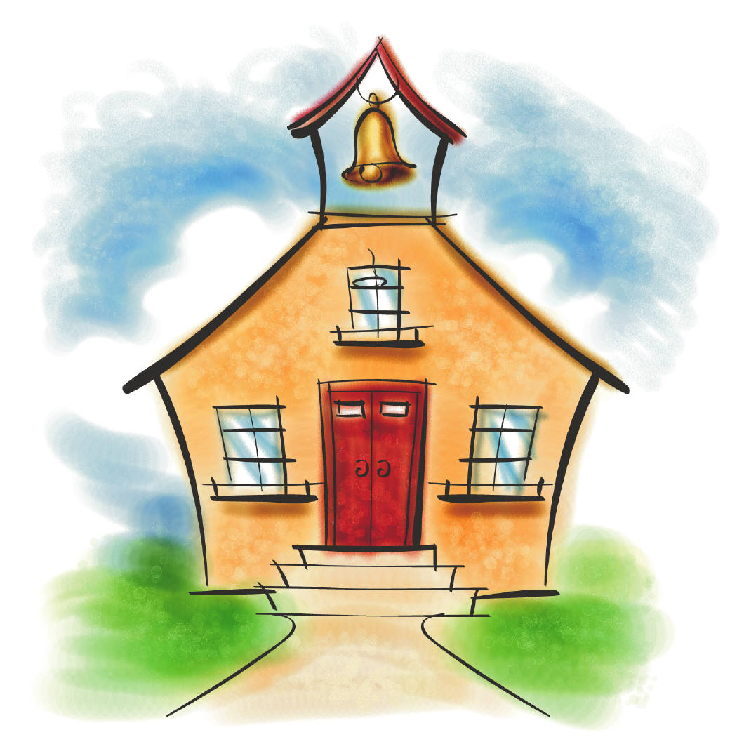
Parent Portal
User Guide
Gates County Schools
T. S. Cooper Elementary School
Dr. Barry Williams, Superintendent
Lola N. Rountree, Director of Student Data Systems
Lauren Hargett, Elementary Data Manager

Slide 2
Getting Started
PowerSchool Parent Portal gives parents and students access to real-time information including attendance, grades and detailed assignment descriptions. Students can stay on top of their assignments and parents are able to participate more fully in their students progress.
The Custodial Parent/Guardian will receive a Confidential ID and Password for their students. With the ID and Password the Custodial Parent/Guardian will have the ability to create an account and access student academic information in Parent Portal.
If you are not the custodial parent or you do not live at the same address as your child you may be given access to Parent Portal with the permission of the custodial parent. Please contact the school where your child attends to acquire an account.
Students grades for the previous week are required to be posted to the Parent Portal no later than 5PM on the following Monday. Please contact your schools principal with any questions or concerns in regards to grades posting or not posting on time.
When viewing your students grades, if you have any questions, please contact the teacher via email. You can click on the teachers name in Parent Portal or locate the teachers email at the school’s website.

Slide 3
How to Access Parent Portal https://gates.powerschool.com/public
In order to access your child’s information you must first create an account.
Creating an account will allow you to add multiple children to your account so you can view all your children under one account, instead of going to each individual student account.
An email address is required to create an account with Parent Portal.

Slide 4
Creating Your Parent Account
https://gates.powerschool.com/public
Click on Create Account at the bottom of the page.
Enter your First and Last Name, Email address, Desired Username and Password. You will be asked to reenter your Password.
Link Students to account: Enter your child’s full name, your Access ID, your Access Password, and Relationship for each student you wish to add to your Parent Account. (Use the Access Password and Access ID given to you as the parent)
When you have completed linking your children select ENTER.

Slide 5
Creating your Account Cont.
Once you have created your account you may now login Parent Portal on the main page.
If you have linked your students you will see their names at the top left of the screen. To view another student all you have to do is click on that student’s name.
To view Grades and Attendance in more detail click on the hyperlink in blue.
You may change your Username and Password under Account Preferences. You will also be able to add additional students to your account even after it has been created.
Please contact your student’s teacher via email with any questions or concerns related to Grades and Assignments.
If you are having issues with navigating thru Parent Portal, or have a question regarding your child’s Attendance please contact Lauren Hargett (hargettlm@gatescountyschools.net) or call (252) 465-4091.

Slide 6
Available Information
Grades and Attendance
State Test Results (Not available at this time)
Grade History
Attendance History
Email Notification
Teacher Comments
School Bulletin
Class Registration
My Calendars
School Information
Account Preferences

Slide 7
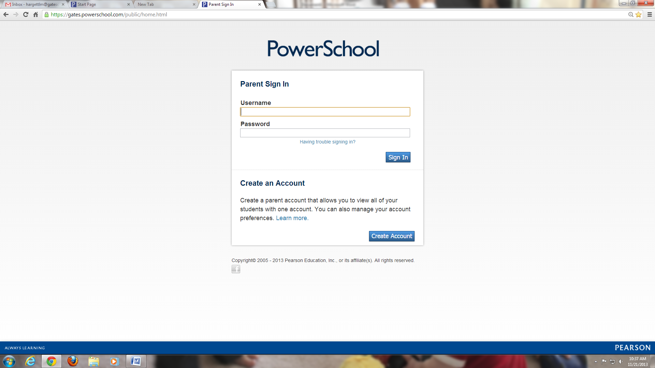
Notes:
Option #1

Slide 8
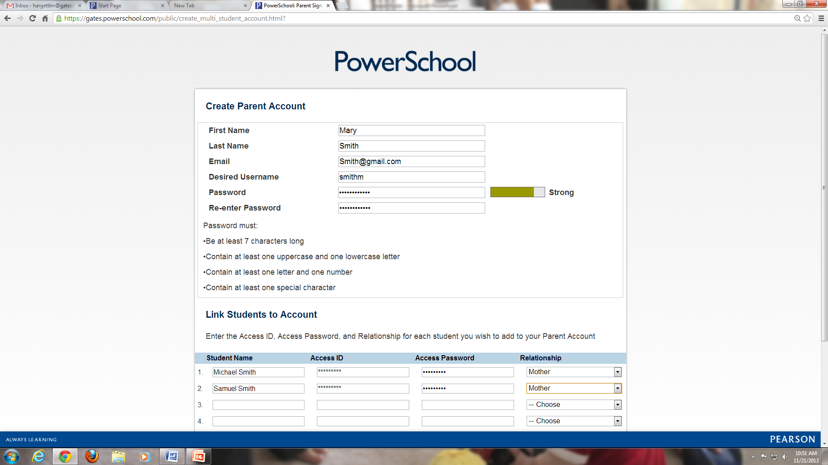

Slide 10
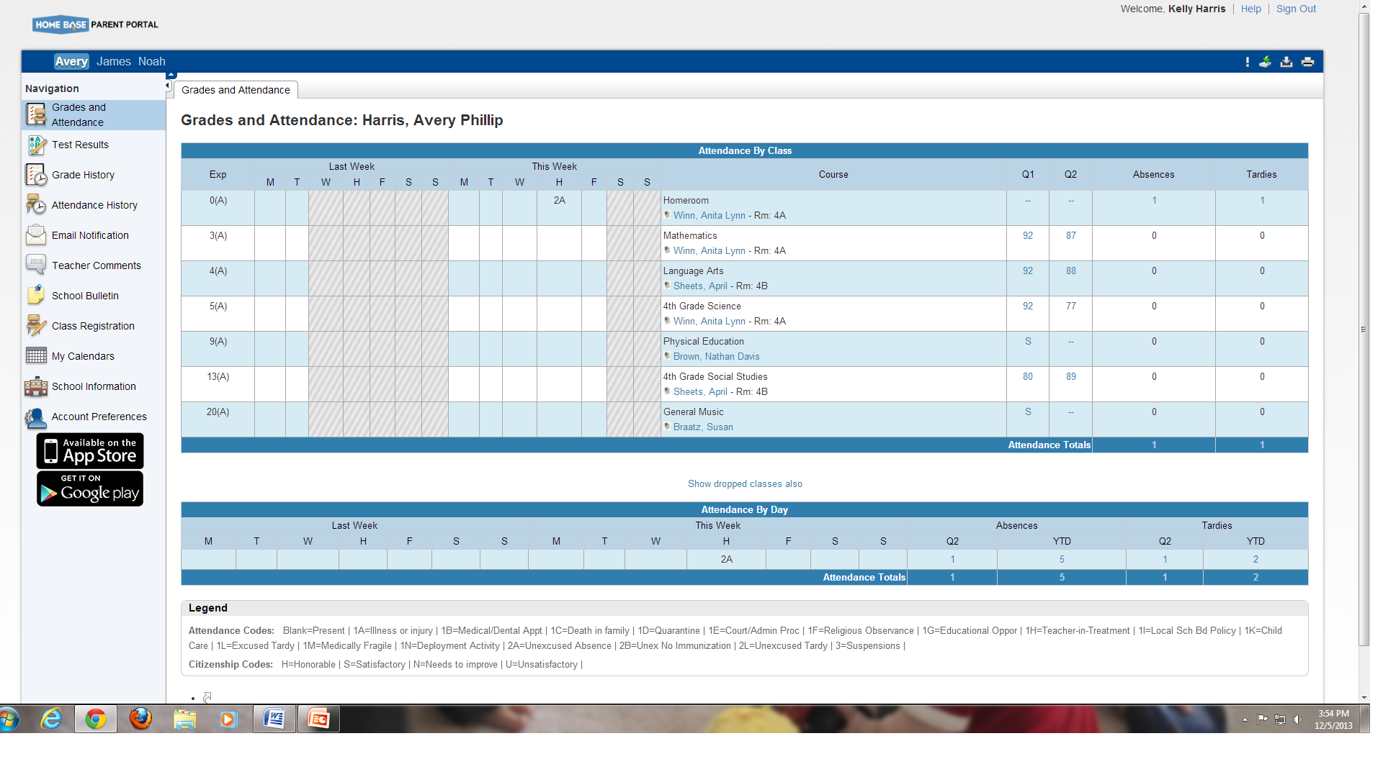
Click on the help button for additional information
  Click on the hyperlink to view Grades in more detail
Click on hyperlink to view Attendance in more detail

Slide 11
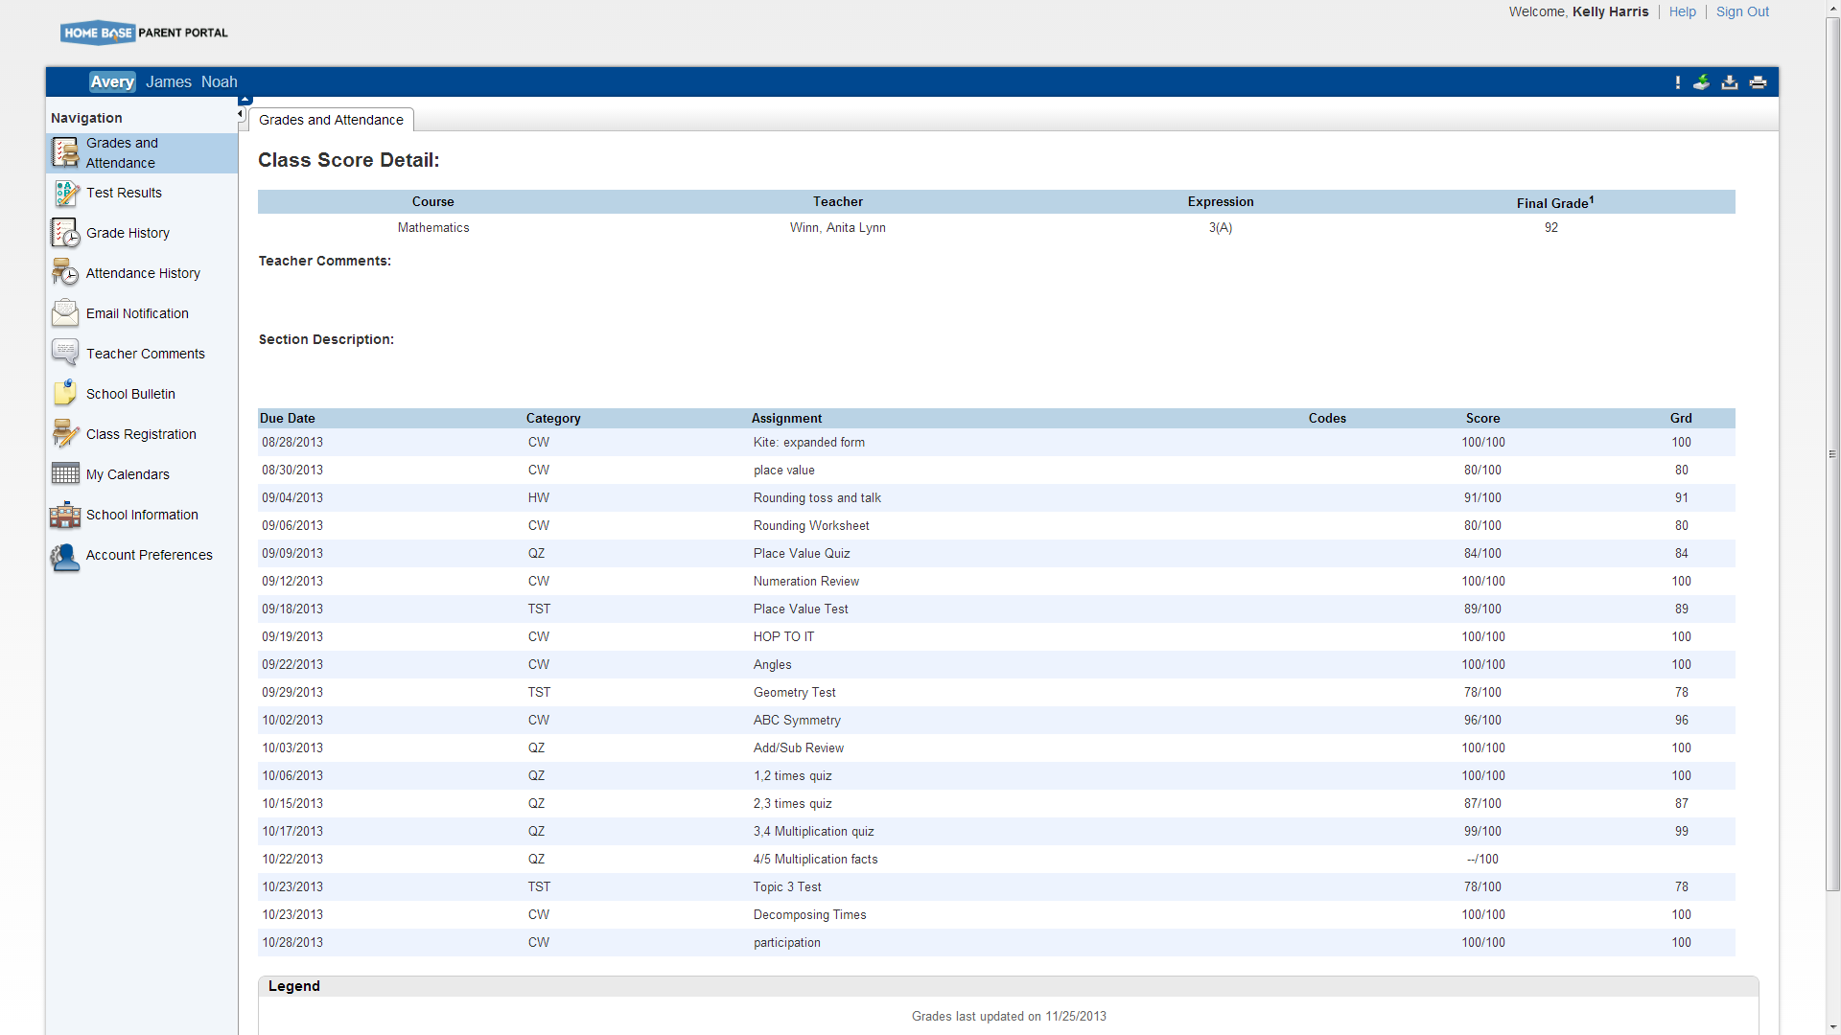
**This final grade may include assignments that are not yet published by the teacher. It may also be a result of special weighting used by the teacher. Please contact your child’s teacher with any questions.
View Assignments and Grades

Slide 12
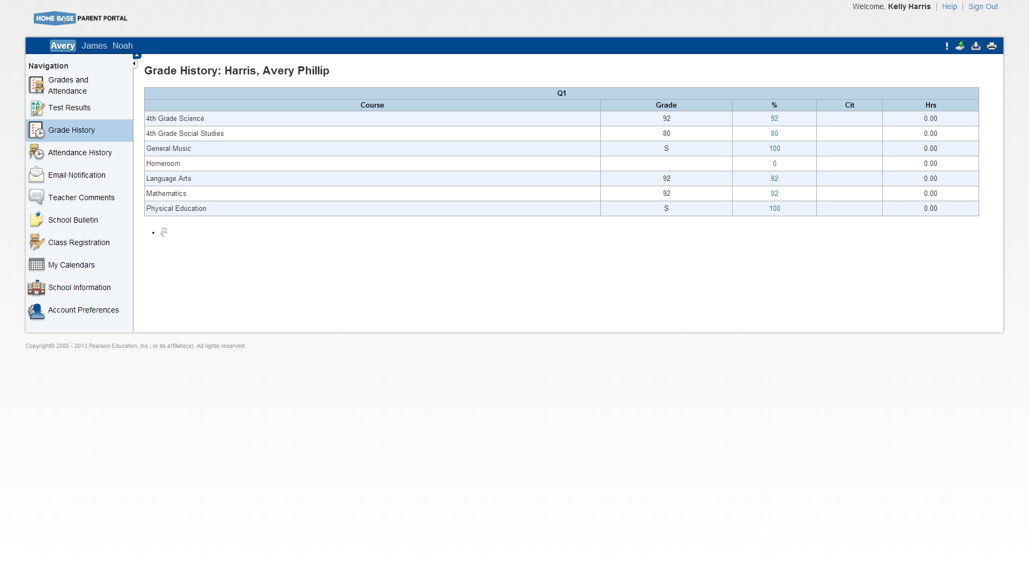
**The Grade History Screen will show you Historical Grades posted from the previous grading period.

Slide 13
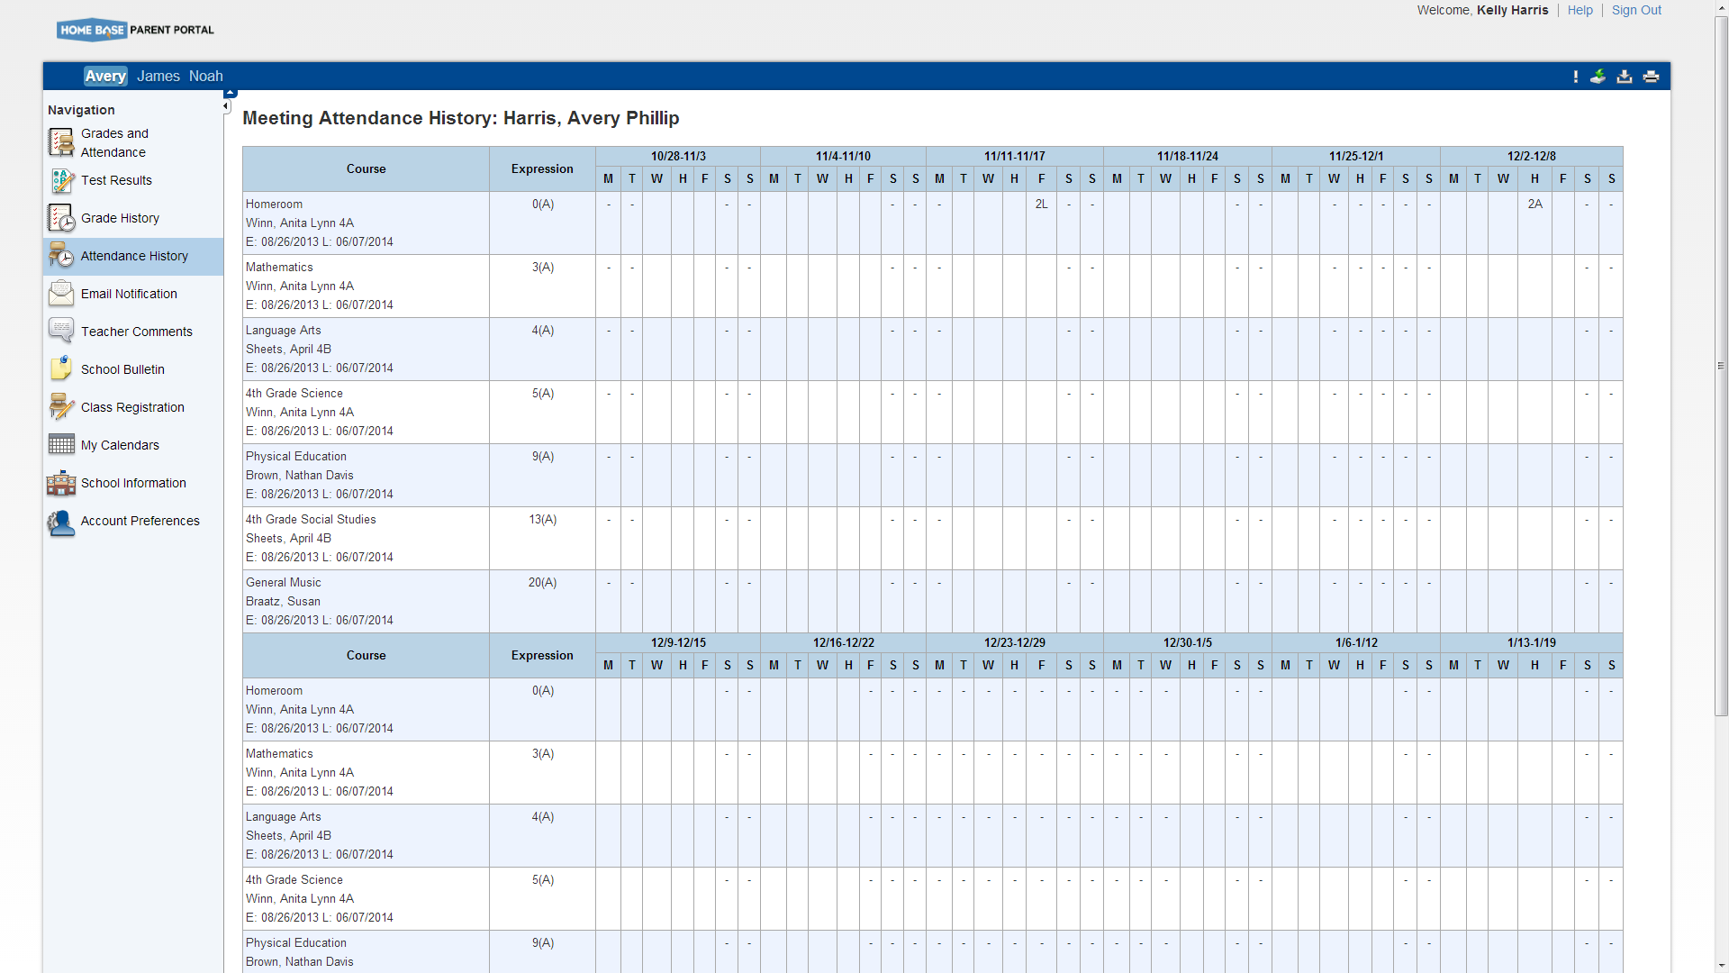
****Attendance History gives you an overall view of your child’s attendance to date.

Slide 14
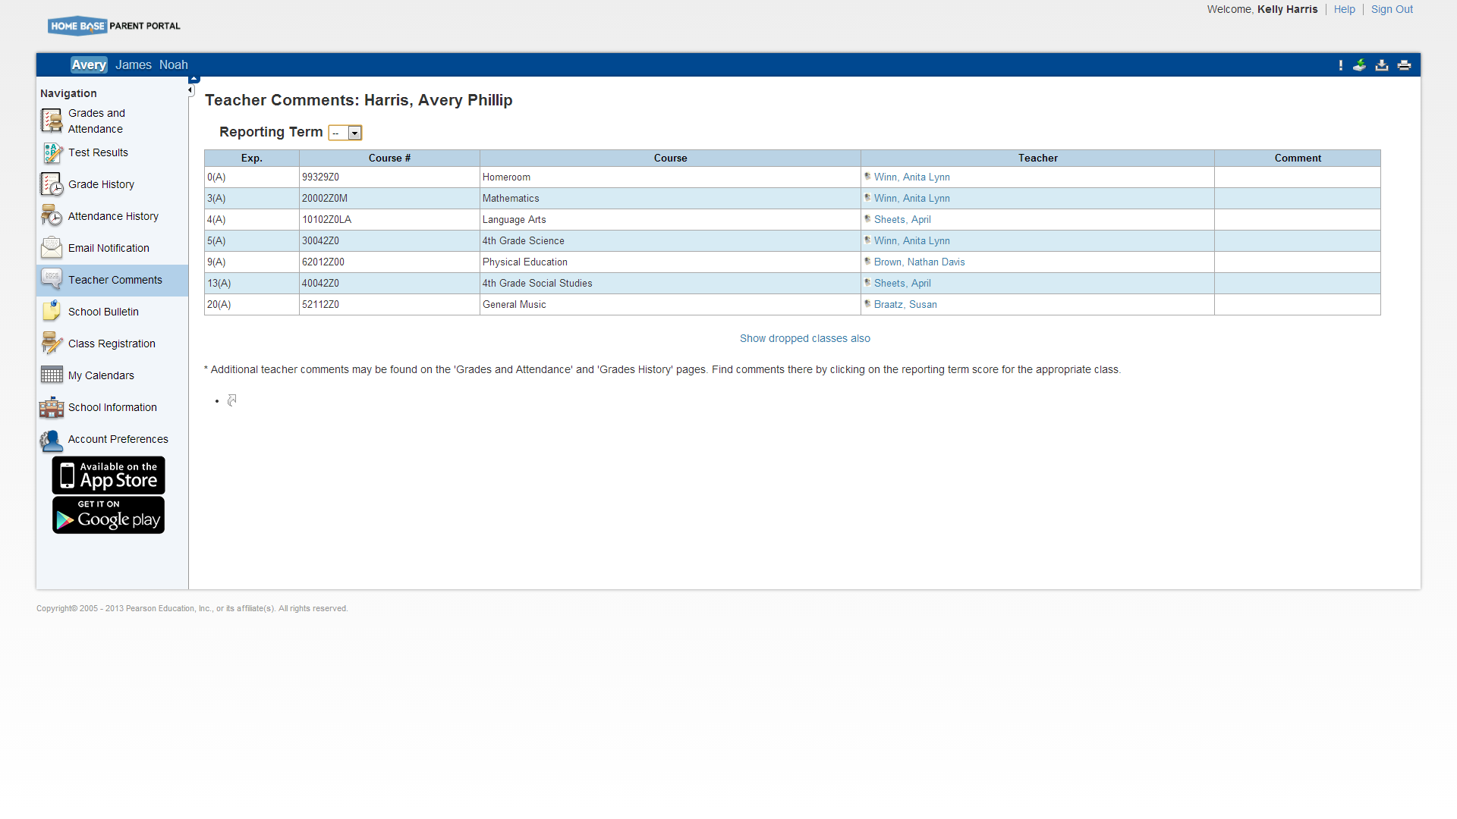
Select a reporting term to view teacher comments
Click on the teachers name to send an email
**Note: To use the e-mail function, your Web browser
must be properly configured to automatically open an e-mail
application, and the e-mail application must be properly
configured to send e-mail messages.

Slide 15
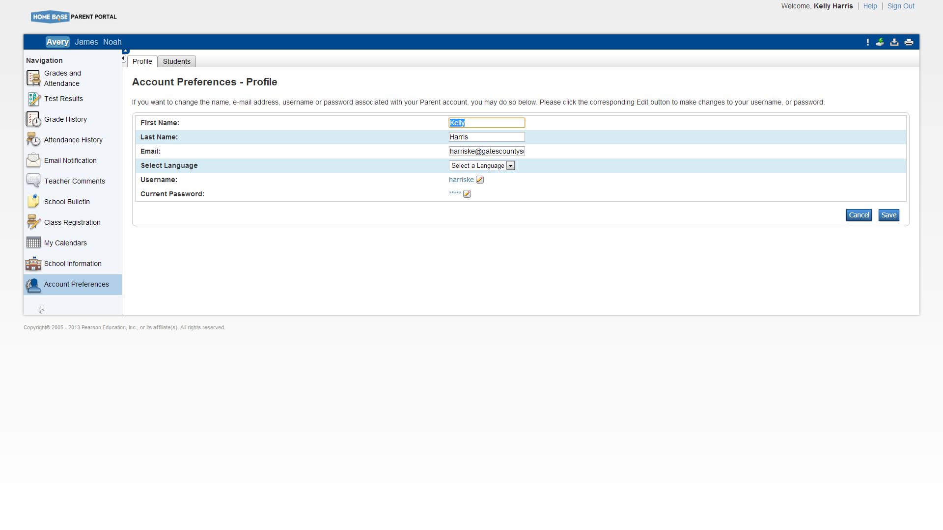
To add additional students to your account select the Students tab.
**Under Account Preferences you can change your username and password. Click on the pencil to edit.

Slide 16
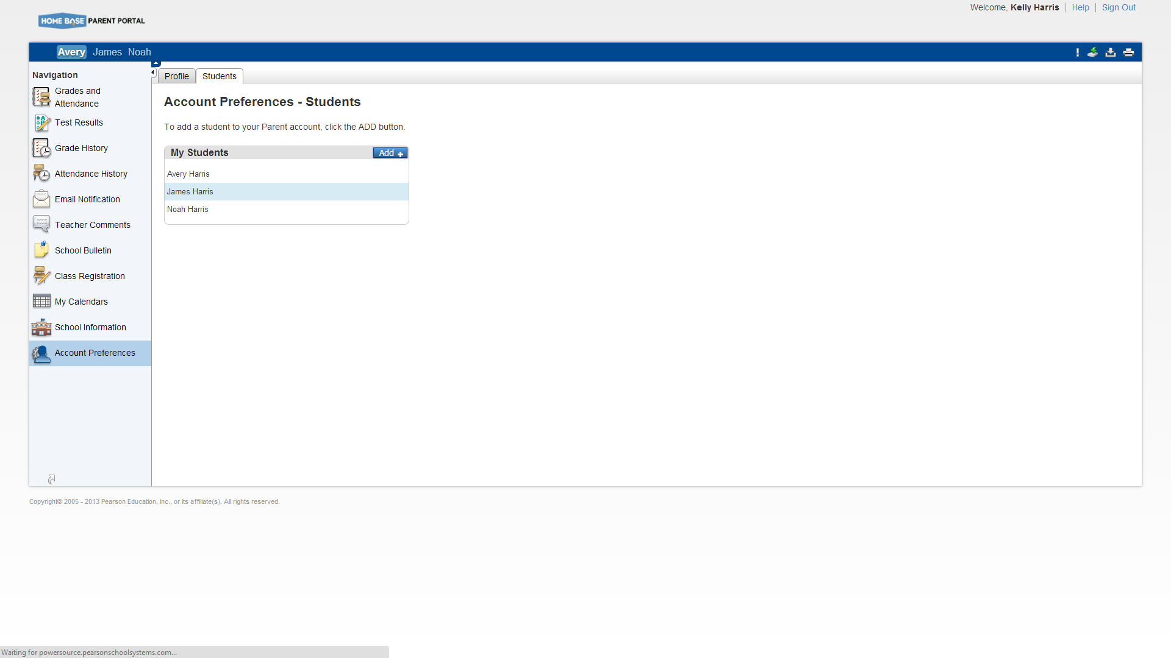
*Click on the Add button to add more students to your account.
**Enter your students name and the ID and Password given to you by the Data Manager and Submit.

